Slide 1
Announcements
Homework 3 out (due 10/4)
Midterm next week! (10/6)

Slide 2
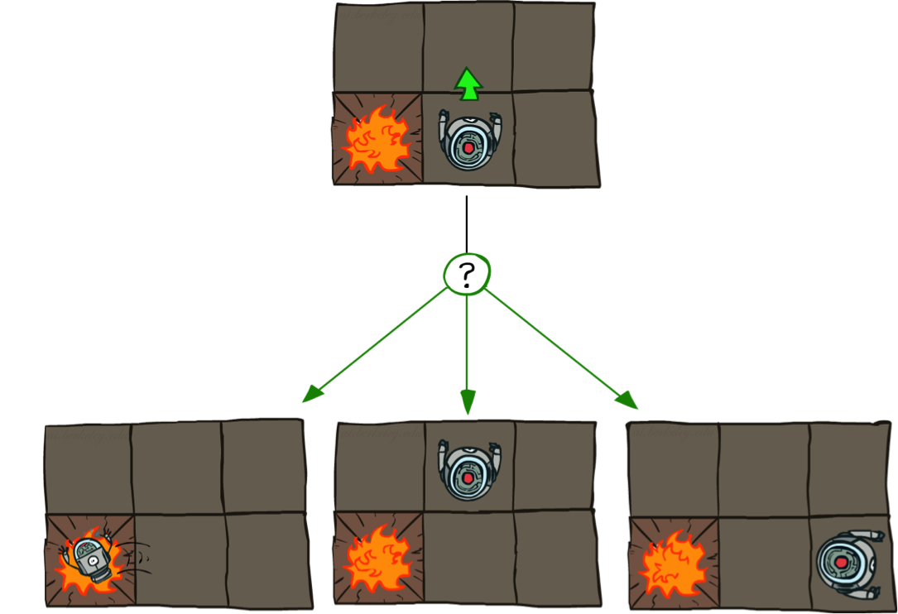
Last time: Markov Decision Processes
Defined by:
A set of states s ∈ S
A set of actions a ∈ A
A transition function T(s, a, s’)
Probability that a from s leads to s’, i.e., P(s’| s, a)
A reward function R(s, a, s’)
Sometimes just R(s) or R(s’)
A start state
Maybe a terminal state

Slide 3
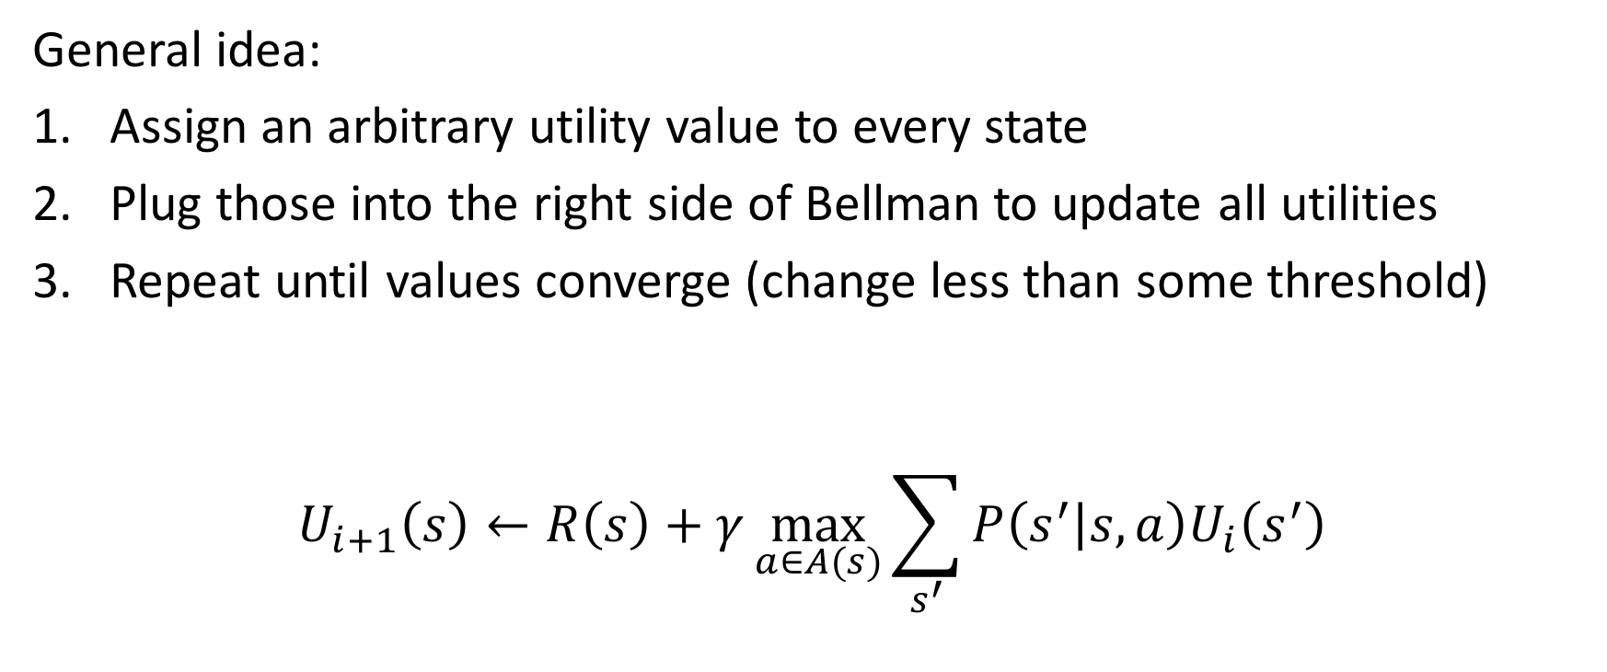
Last time: Value Iteration
General idea:
Assign an arbitrary utility value to every state
Plug those into the right side of Bellman to update all utilities
Repeat until values converge (change less than some threshold)
$$U_{i+1}\left(s\right)←R\left(s\right)+γ\max_{a∈A(s)}{\sum_{s^{′}}{P\left(s^{′} | s,a\right)U_{i}\left(s^{′}\right)}}$$

Slide 4


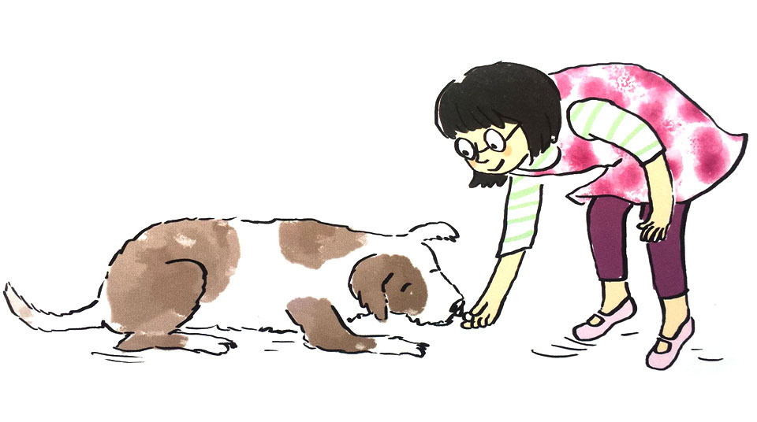
Today: Reinforcement learning

Slide 5

Today: Reinforcement learning
Defined by:
A set of states s ∈ S
A set of actions a ∈ AA start state
Maybe a terminal state
No longer know
transition function T(s, a, s’)
reward function R(s)
But, we do observe two things:
End state s’ after taking action a from state s
Reward R(s’) when we enter s’
How would you use these to learn a decision policy for any state?

Slide 6
Reinforcement Learning
Agent
State: s
Reward: r
Actions: a
Environment
Basic idea:
Receive feedback in the form of rewards
Agent’s utility is defined by the reward function
Must (learn to) act so as to maximize expected rewards
All learning is based on observed samples of outcomes!

Slide 7
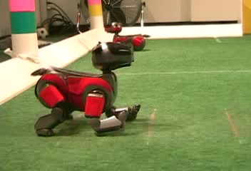
Example: Aibo
Initial gait

Slide 8

Example: Aibo
Training

Slide 9
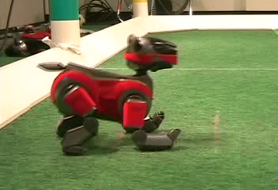
Example: Aibo
Gait at end of training

Slide 10
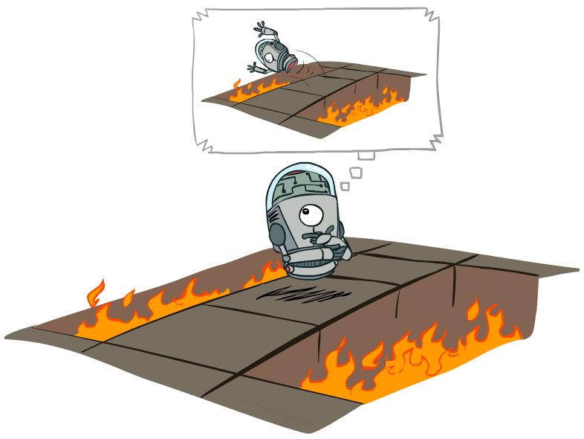
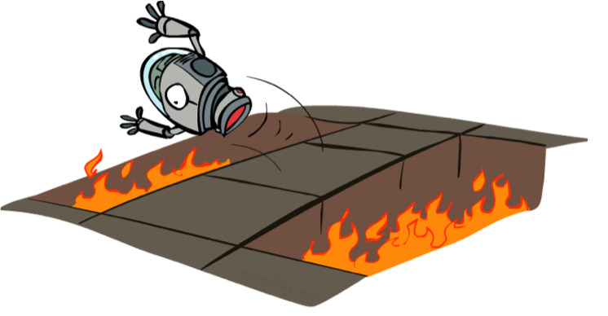
Offline (MDPs) vs. Online (RL)
Offline Computation
Online Learning

Slide 11
Approaches we’ll take for RL
Model-based learning
Try a bunch of things until we know enough to pretend it’s an MDP!
Model-free learning
Focus on the policy, not the transition/reward model.
Passive – use a fixed policy and iterate
Active – try to figure it all out at once

Slide 12


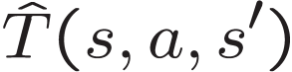
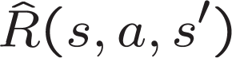
Model-based learning
General idea:
Learn an approximate model based on experiences
Solve for values as if the learned model were correct
Step 1: Learn empirical MDP model
Count outcomes s’ for each s, a
Normalize to give an estimate of
Discover each when we experience (s, a, s’)
Step 2: Solve the learned MDP
For example, use value iteration, as before

Slide 13
Model-based learning
Input Policy π
Observed Episodes (Training)
Learned Model
Episode 1
Episode 2
T(s,a,s’).
T(B, east, C) = 1.00
T(C, east, D) = 0.75
T(C, east, A) = 0.25
…
R(s,a,s’).
R(B, east, C) = -1
R(C, east, D) = -1
R(D, exit, x) = +10
…
 | A
B | C | D
 | E
B, east, C, -1
C, east, D, -1
D, exit, x, +10
B, east, C, -1
C, east, D, -1
D, exit, x, +10
Episode 3
Episode 4
E, north, C, -1
C, east, D, -1
D, exit, x, +10
E, north, C, -1
C, east, A, -1
A, exit, x, -10
Assume: γ = 1

Slide 14
Problems with model-based learning
This can require a lot of samples!
If have many actions/states, need hundreds/thousands/millions of samples to estimate a good probability distribution
E.g., blackjack
Every transition and reward is independent!
So not leveraging information from action sequence
Lots of extra computation!
First, estimate T and R
Then, solve an MDP
Not very efficient…

Slide 15
Approaches we’ll take for RL
Model-based learning
Try a bunch of things until we know enough to pretend it’s an MDP!
Model-free learning
Focus on the policy, not the transition/reward model.
Passive – use a fixed policy and iterate
Active – try to figure it all out at once

Slide 16
Q function
Before, we used utilities of states
Calculated via expected outcomes with T and R
Now, since T/R are unknown, consider utilites of state-action pairs
What is the expected utility of taking action a from state s?
Called the Q function Q(a,s)

Slide 17
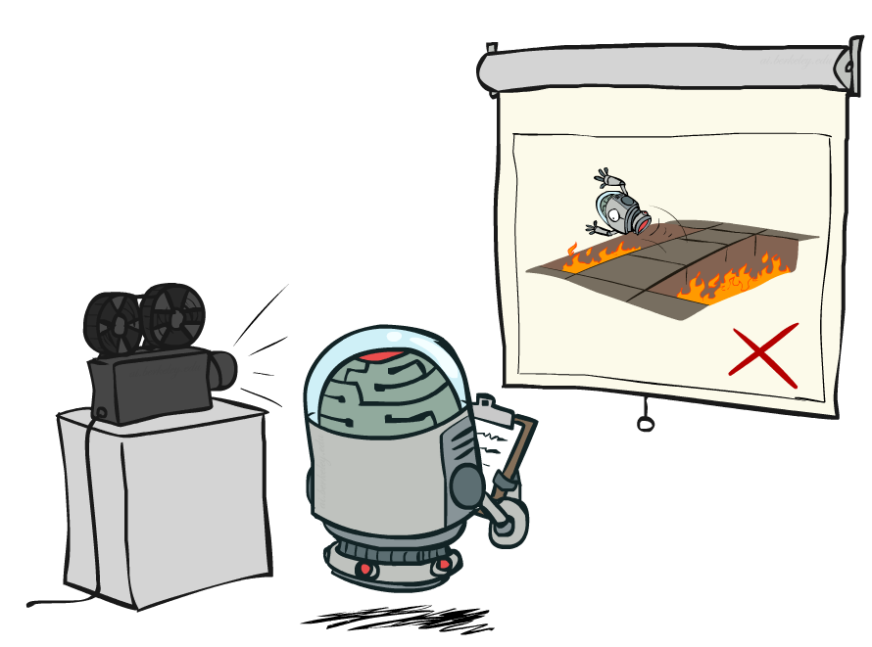
Passive reinforcement learning

Slide 18

Passive reinforcement learning
Simplified task: policy evaluation
Input: a fixed policy π(s)
You don’t know the transitions T(s,a,s’)
You don’t know the rewards R(s,a,s’)
Goal: learn the state-action Q values
In this case:
Learner is “along for the ride”
No choice about what actions to take
Just execute the policy and learn from experience
This is NOT offline planning! You actually take actions in the world.

Slide 19
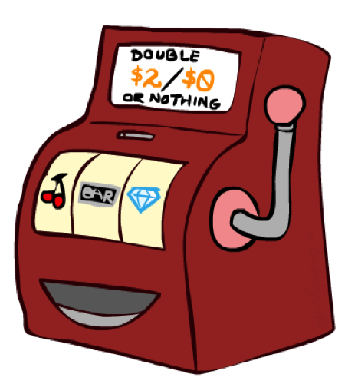
Monte Carlo method (aka Direct Evaluation)
Goal: Compute values for each state under π
Using a fixed policy, so only one action
Q(s,a) = U(s)!
Idea: Average together observed sample values
Act according to π
Every time you visit a state, write down what the sum of discounted rewards turned out to be
Note that you only know these at the end of execution!
Average those samples
Monte Carlo, because using averaged behavior over many random samples

Slide 20
Example: Monte Carlo
Input Policy π
Observed Episodes (Training)
Output Values
Episode 1
Episode 2
 | A
B | C | D
 | E
 | A
B | C | D
 | E
B, east, C, -1
C, east, D, -1
D, exit, x, +10
B, east, C, -1
C, east, D, -1
D, exit, x, +10
-10
+8
+4
+10
Episode 3
Episode 4
-2
E, north, C, -1
C, east, D, -1
D, exit, x, +10
E, north, C, -1
C, east, A, -1
A, exit, x, -10
Assume: γ = 1

Slide 21
Monte Carlo assumptions
We’re making two key assumptions:
Exploring starts
Assume non-zero probability of starting in any state
Allows us to explore outcomes of every state (eventually)
Finite state sequence
Reward signals only come at end of sequence
Assume that we will always hit a terminal state in finite time
Alternatively, use one-step lookahead with current estimates
Like value iteration!

Slide 22
Problems with Direct Evaluation
What’s good about direct evaluation?
It’s easy to understand
It doesn’t require any knowledge of T, R
It eventually computes the true expected utilities, using just sample transitions
What’s bad about it?
Only gives information for one policy
May not visit every state!
It wastes information about state connections
Each state must be learned separately
So, it takes a long time to learn
Output Values
 | A
B | C | D
 | E
-10
+8
+4
+10
-2

Slide 23
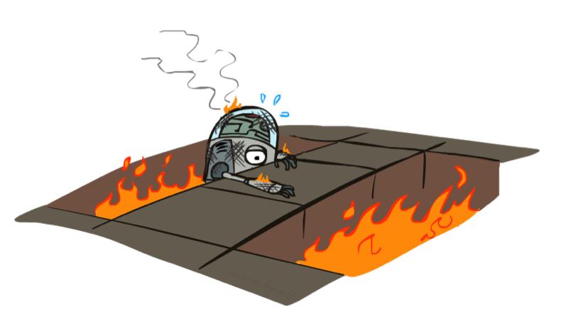
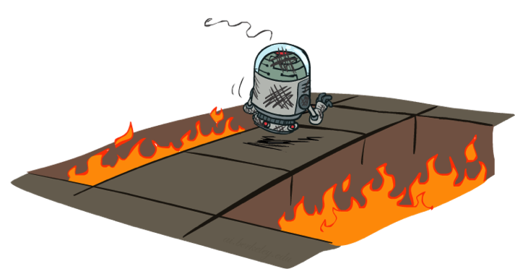
Active Reinforcement Learning

Slide 24
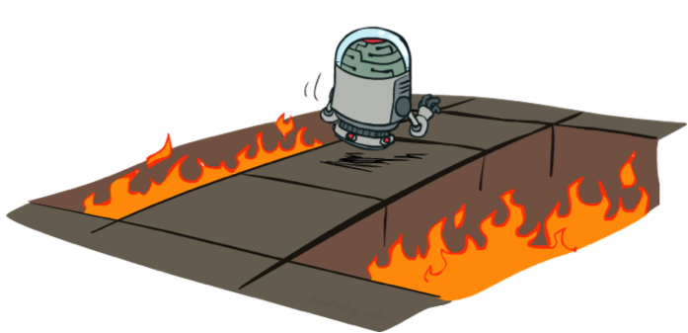
Active Reinforcement Learning
Full reinforcement learning: optimal policies (like value iteration)
You don’t know the transitions T(s,a,s’)
You don’t know the rewards R(s,a,s’)
You choose the actions now
Goal: learn the optimal policy and values
In this case:
Learner makes choices!
Fundamental tradeoff: exploration vs. exploitation
This is NOT offline planning! You actually take actions in the world and find out what happens…

Slide 25
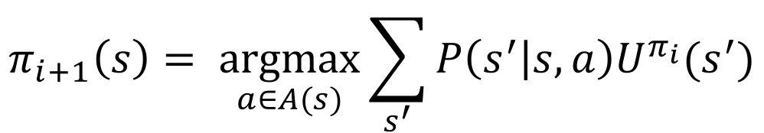
Mutable policies
Think back to policy iteration
We have the evaluation step for a fixed policy
How do we calculate a better policy?
Policy update for an MDP:
$$π_{i+1}\left(s\right)= \underset{a∈A(s)}{argmax}{\sum_{s^{′}}{P\left(s^{′} | s,a\right)U^{π_{i}}(s^{′})}}$$
Instead of unknown transition probabilities, use Q values!

Slide 26
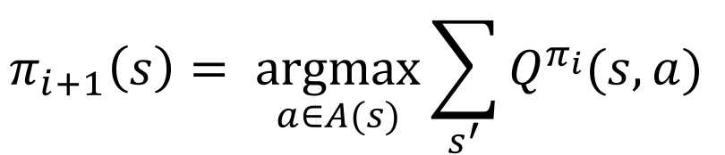
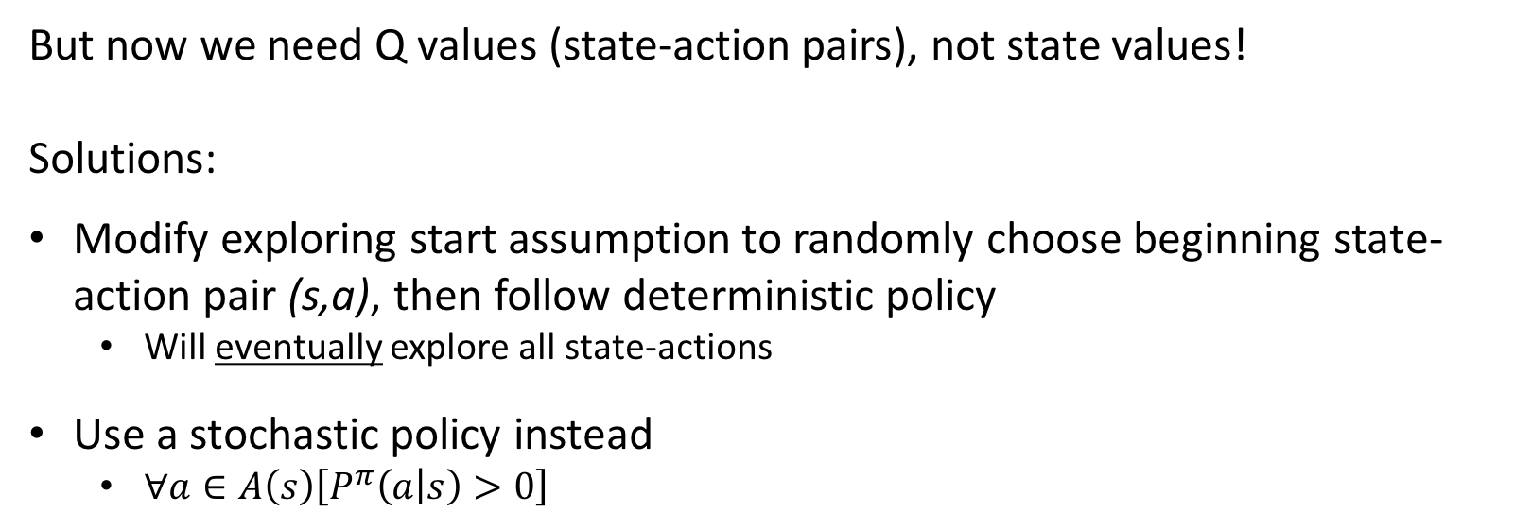
Mutable policies
$$π_{i+1}\left(s\right)= \underset{a∈A(s)}{argmax}{\sum_{s^{′}}{Q^{π_{i}}(s,a) }}$$
Policy update for Monte Carlo:
But now we need Q values (state-action pairs), not state values!
Solutions:
Modify exploring start assumption to randomly choose beginning state-action pair (s,a), then follow deterministic policy
Will eventually explore all state-actions
Use a stochastic policy instead
$∀a∈A\left(s\right)\left[P^{π}\left(a | s\right)>0\right]$
We’ll assume exploring starts
Both options calculate all (s,a) pairs
Exploring start makes computation simpler

Slide 27
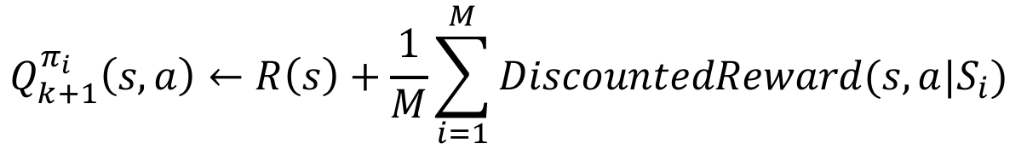
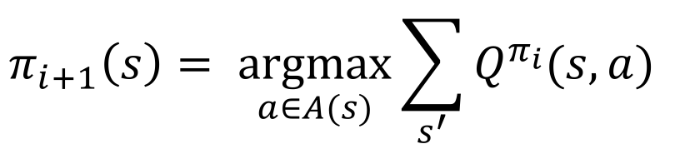
Generalized Policy Iteration
Evaluation:
For fixed current policy π, use N starts into random (s₀,a₀) and run the policy to halt.
Then, for each (s,a), go through the N episodes and find the M episodes that use (s,a)
Update Q(s,a) with the average of discounted rewards starting at (s,a) on in each episode S_{i}
Improvement: With sampled Q values, get a better policy using policy extraction
$$Q_{k+1}^{π_{i}}\left(s,a\right)←R\left(s\right)+\frac{1}{M}\sum_{i=1}^{M}{DiscountedReward(s,a|S_{i}) }$$
$$π_{i+1}\left(s\right)= \underset{a∈A(s)}{argmax}{\sum_{s^{′}}{Q^{π_{i}}(s,a) }}$$

Slide 28
Example: Evaluation
Input Policy π
Observed Episodes (Training)
Output Values
Episode 1
Episode 2
 | A
B | C | D
 | E
B, east, C, -1
C, north, A, -1
A, exit, x, -10
 | A
B | C | D
 | E
C, east, D, -1
D, exit, x, +10
-11
-12
-1
Episode 3
Episode 4
-12
-13
E, east, E, -1
E, north, C, -1
C, north, A, -1
A, exit, x, -10
E, north, C, -1
C, east, A, -1
A, exit, x, -10
Assume: γ = 1,
Stochastic action sampling w/ prob 0.1

Slide 29
Example: Improvement
Output Values
Output Policy π_{t+1}
 | A
B | C | D
 | E
 | A
B | C | D
 | E
-11
-8
-1
-12
-13
Assume: γ = 1

Slide 30
Have we solved everything?
The good stuff
Can now use estimated outcome values to update policies
Still getting away without T or R!
Generalized policy iteration will converge to optimal policy in limit
The not-so-good stuff
May take a large number of samples to get good Q estimates
Learning still only propagates from the final reward
Still assuming finite state sequences!

Slide 31
Temporal-Difference (TD) Learning
Combine sample-based learning of Monte Carlo and dynamic programming efficiency of lookaheads
Basic Idea
Use lookahead with current estimates to learn from every experience!
Start with evaluation of fixed policy first
Then use GPI to learn new policies

Slide 32
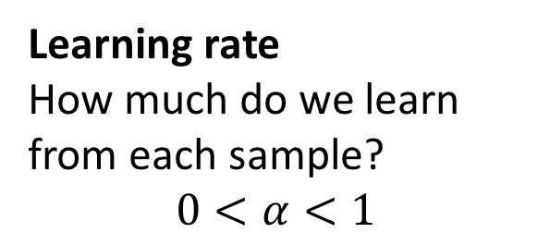
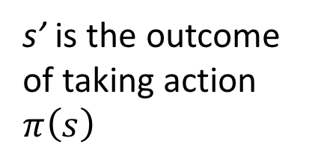
TD evaluation
Update current utility estimate for state s every time we take an action from it:
TD error at this timestep
$$U_{t+1}^{π}\left(s\right)=U_{t}^{π}\left(s\right)+α\left[R\left(s^{′}\right)+γU_{t}^{π}\left(s^{′}\right)−U_{t}^{π}\left(s\right)\right]$$
Learning rate
How much do we learn from each sample?
$$0<α<1$$
s’ is the outcome of taking action $π\left(s\right)$

Slide 33
TD evaluation
Update current utility estimate for state s every time we take an action from it:
$$U_{t+1}^{π}\left(s\right)=U_{t}^{π}\left(s\right)+α\left[R\left(s^{′}\right)+γU_{t}^{π}\left(s^{′}\right)−U_{t}^{π}\left(s\right)\right]$$
$$U_{t+1}^{π}\left(s\right)={(1−α)U}_{t}^{π}\left(s\right)+α\left[R\left(s^{′}\right)+γU_{t}^{π}\left(s^{′}\right)\right]$$
If we extend the lookahead to the end of the sequence, get Monte Carlo estimation
In the limit, will converge to true expected utility of s
And faster than Monte Carlo!
Finite lookahead allows dealing with infinite experience sequences!

Slide 34
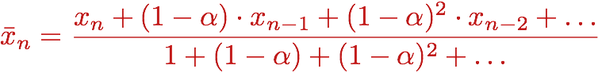
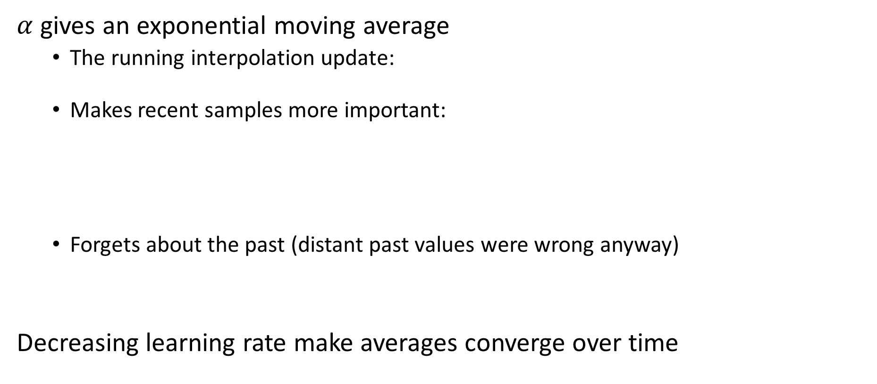
Effect of learning rate
$α$ gives an exponential moving average
The running interpolation update:
Makes recent samples more important:
Forgets about the past (distant past values were wrong anyway)
Decreasing learning rate make averages converge over time

Slide 35
Example: Temporal Difference learning
States
Observed Transitions
B, east, C, -2
C, east, D, -2
 | A
B | C | D
 | E
 | 0
0 | 0 | 8
 | 0
 | 0
-1 | 0 | 8
 | 0
 | 0
-1 | 3 | 8
 | 0
Assume: γ = 1, α = 1/2
$$U_{t+1}^{π}\left(s\right)={(1−α)U}_{t}^{π}\left(s\right)+α\left[R\left(s^{′}\right)+γU_{t}^{π}\left(s^{′}\right)\right]$$

Slide 36
Sarsa: learning policies with TD
Like before, now estimate Q values for state-action pairs instead of state utilities
$$Q_{t+1}\left(s,a\right)←Q_{t}\left(s,a\right)+α\left[R\left(s^{′}\right)+γQ_{t}\left(s^{′},a^{′}\right)−Q_{t}\left(s,a\right)\right]$$
Uses all of s, a, R, s’, a’
Hence, Sarsa
a, a’ both chosen by current policy
Now, can use updated Q values to extract new policy $π_{t+1}$!

Slide 37
Next Time
On-policy vs Off-policy TD learning
Sarsa vs Q learning
Stochastic policies
Generalization for realistic learning

